Slide 1
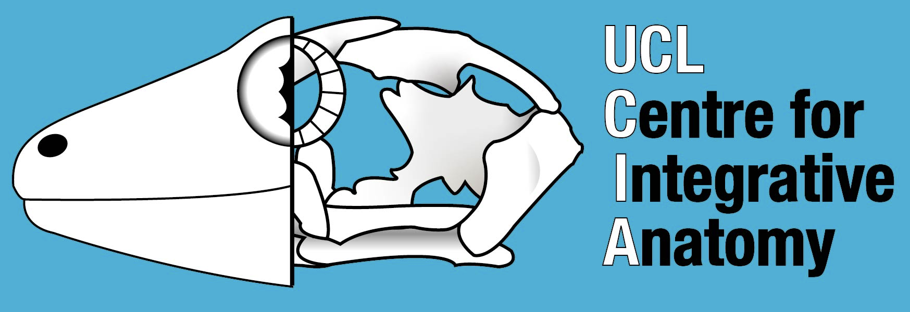
Who am I and Why am I here?
Ryan N. Felice
Analytical Paleobiology Workshop - Erlangen 2023

Slide 2
Background
Bachelors of Science: Tulane University (New Orleans, USA) 2009
PhD: Ohio University (Ohio, USA) 2015
Postdoc: UCL and Natural History Museum (London) 2015-2018
Lecturer: UCL (London) 2015-present

Slide 3
Research Interests
Vertebral evolution
Craniofacial evolution
Macroevolutionary modelling
Methods development

Slide 4
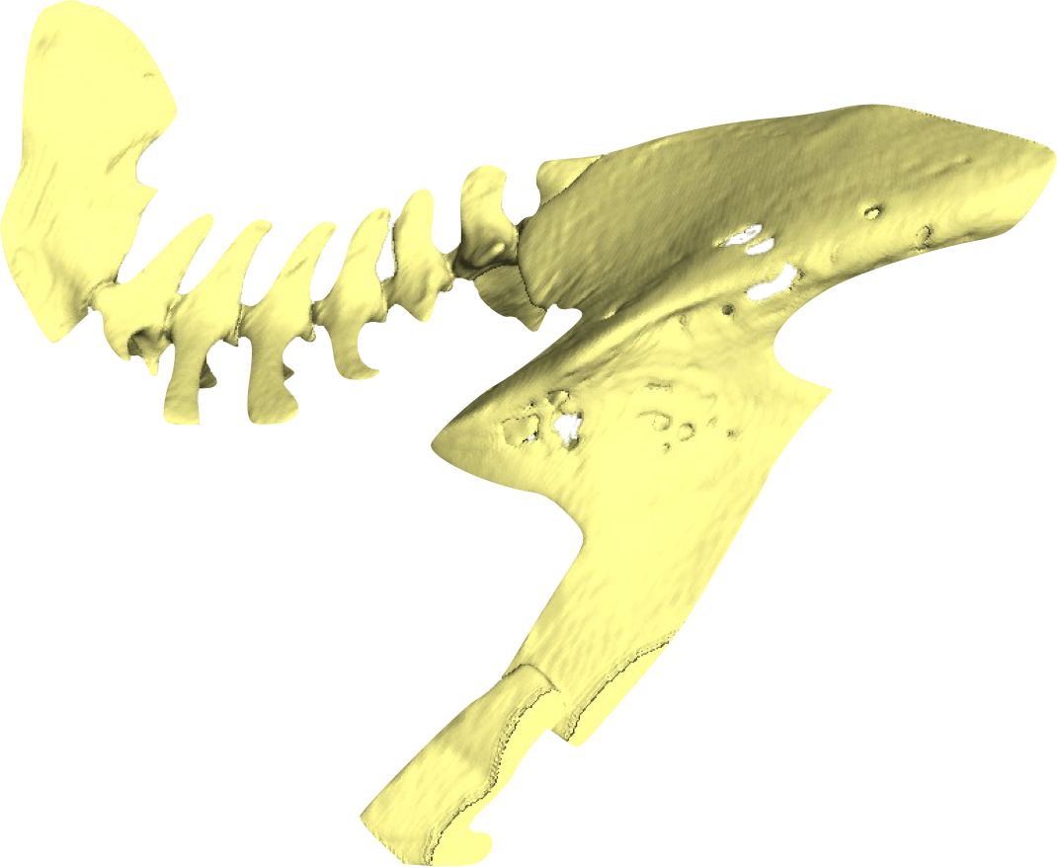
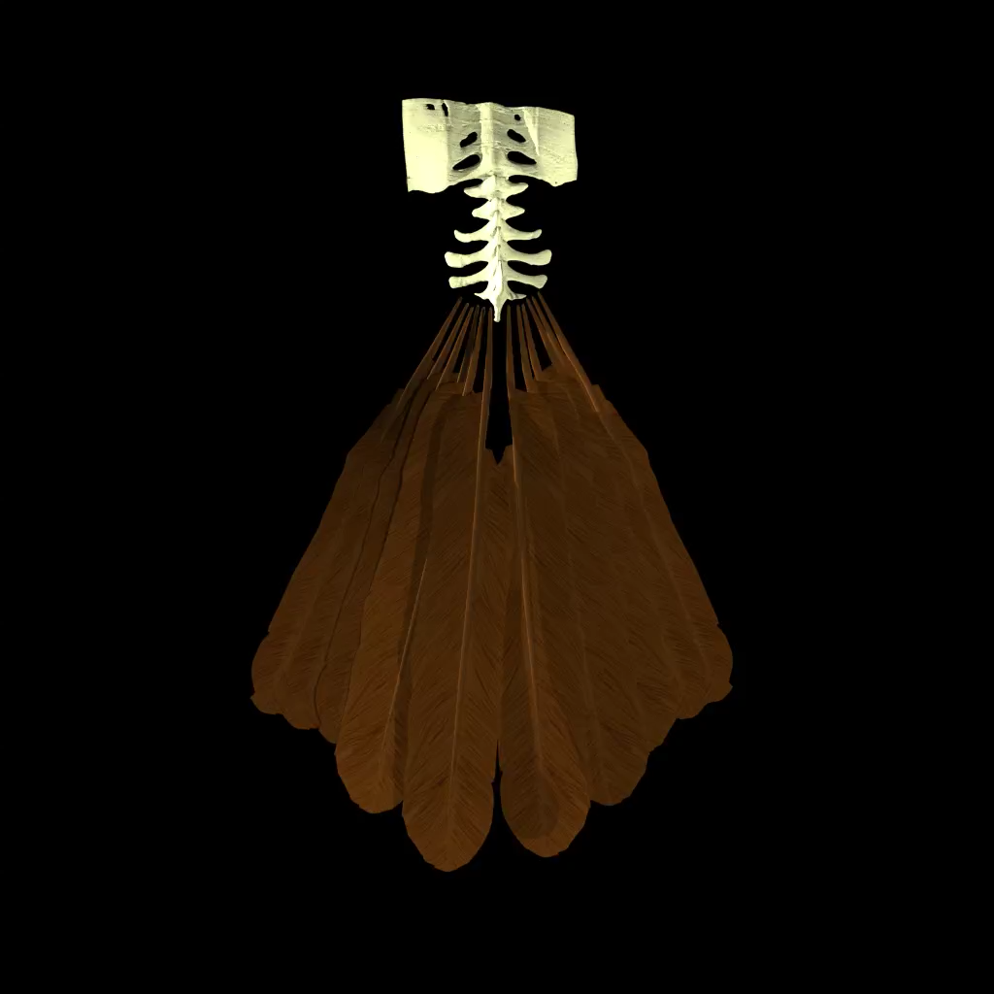
PhD Project

Slide 5
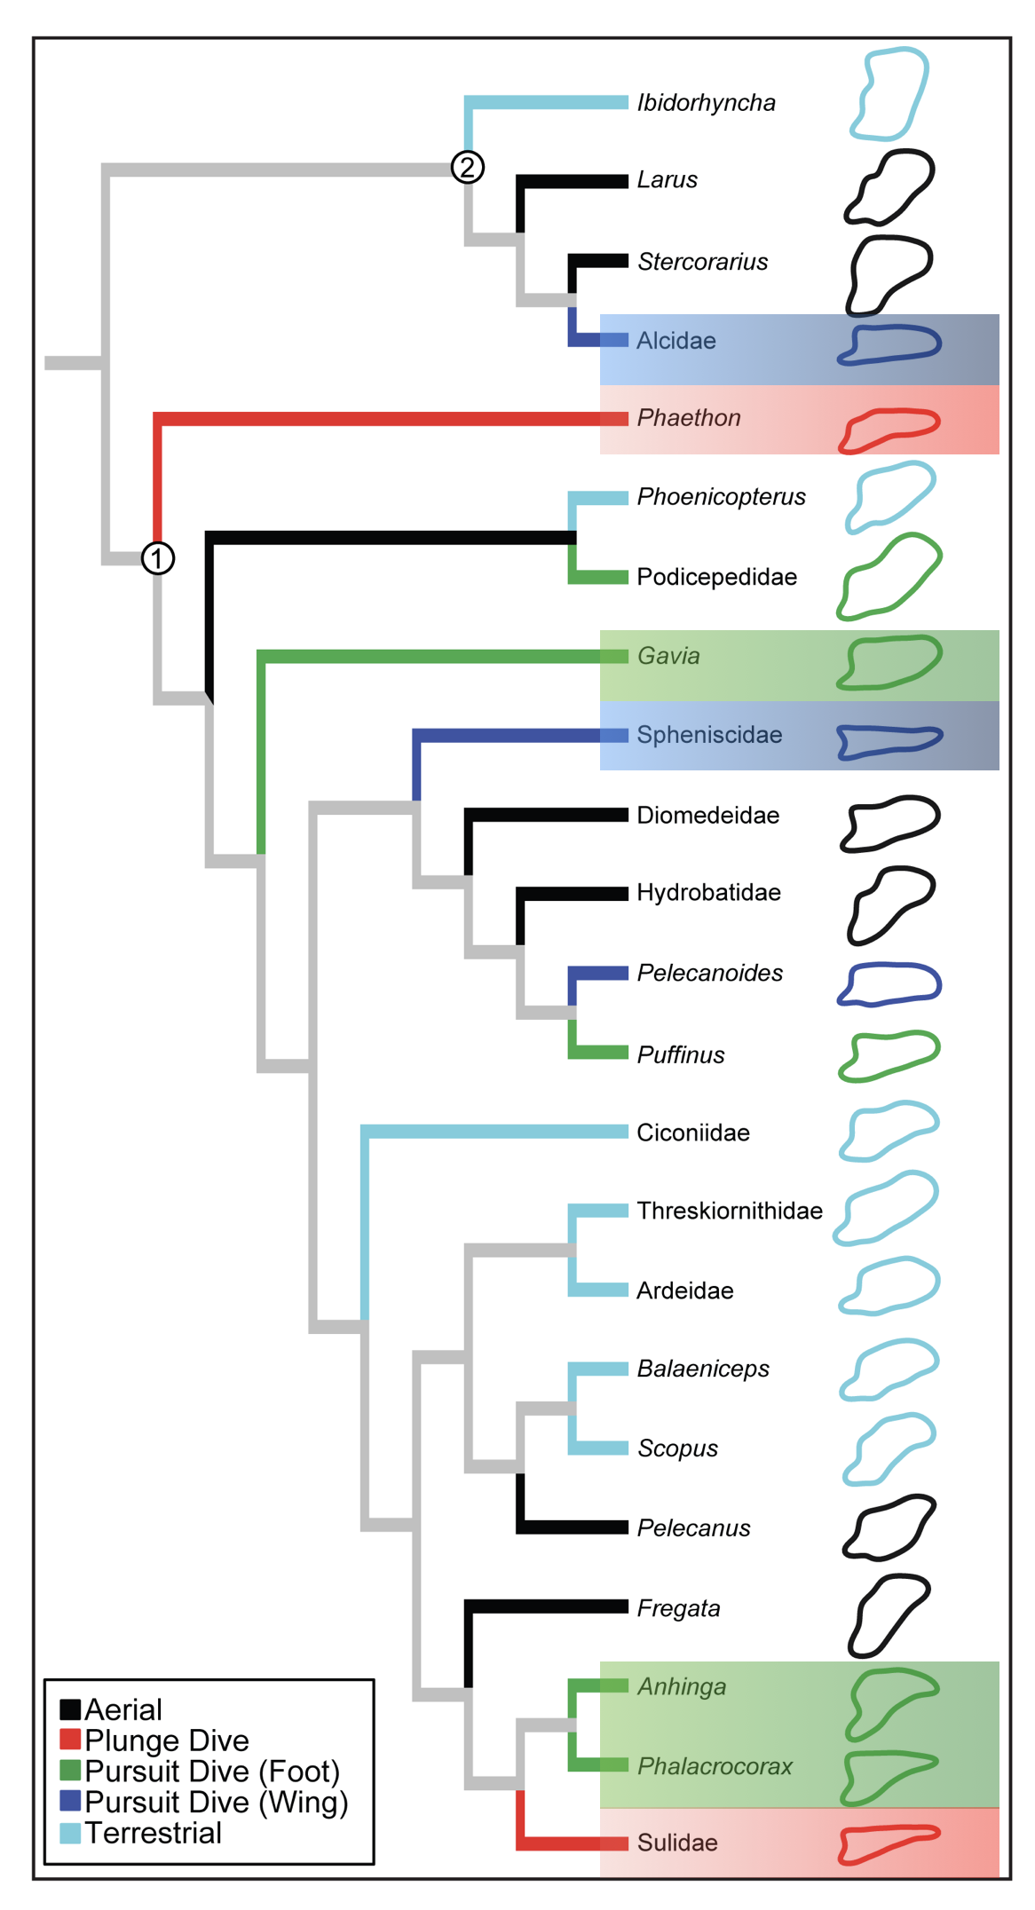

Slide 6
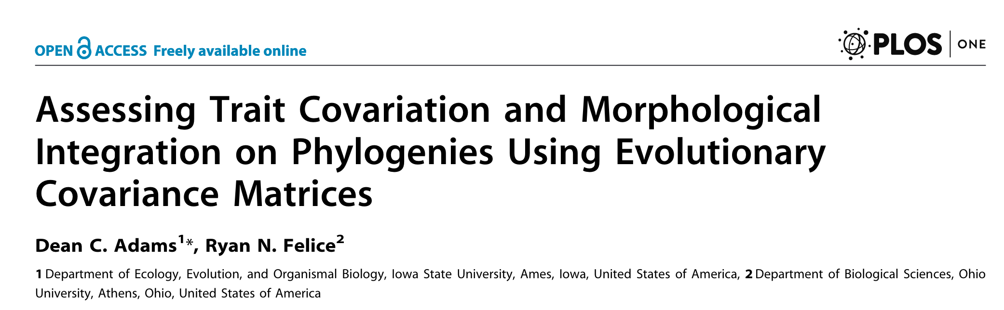
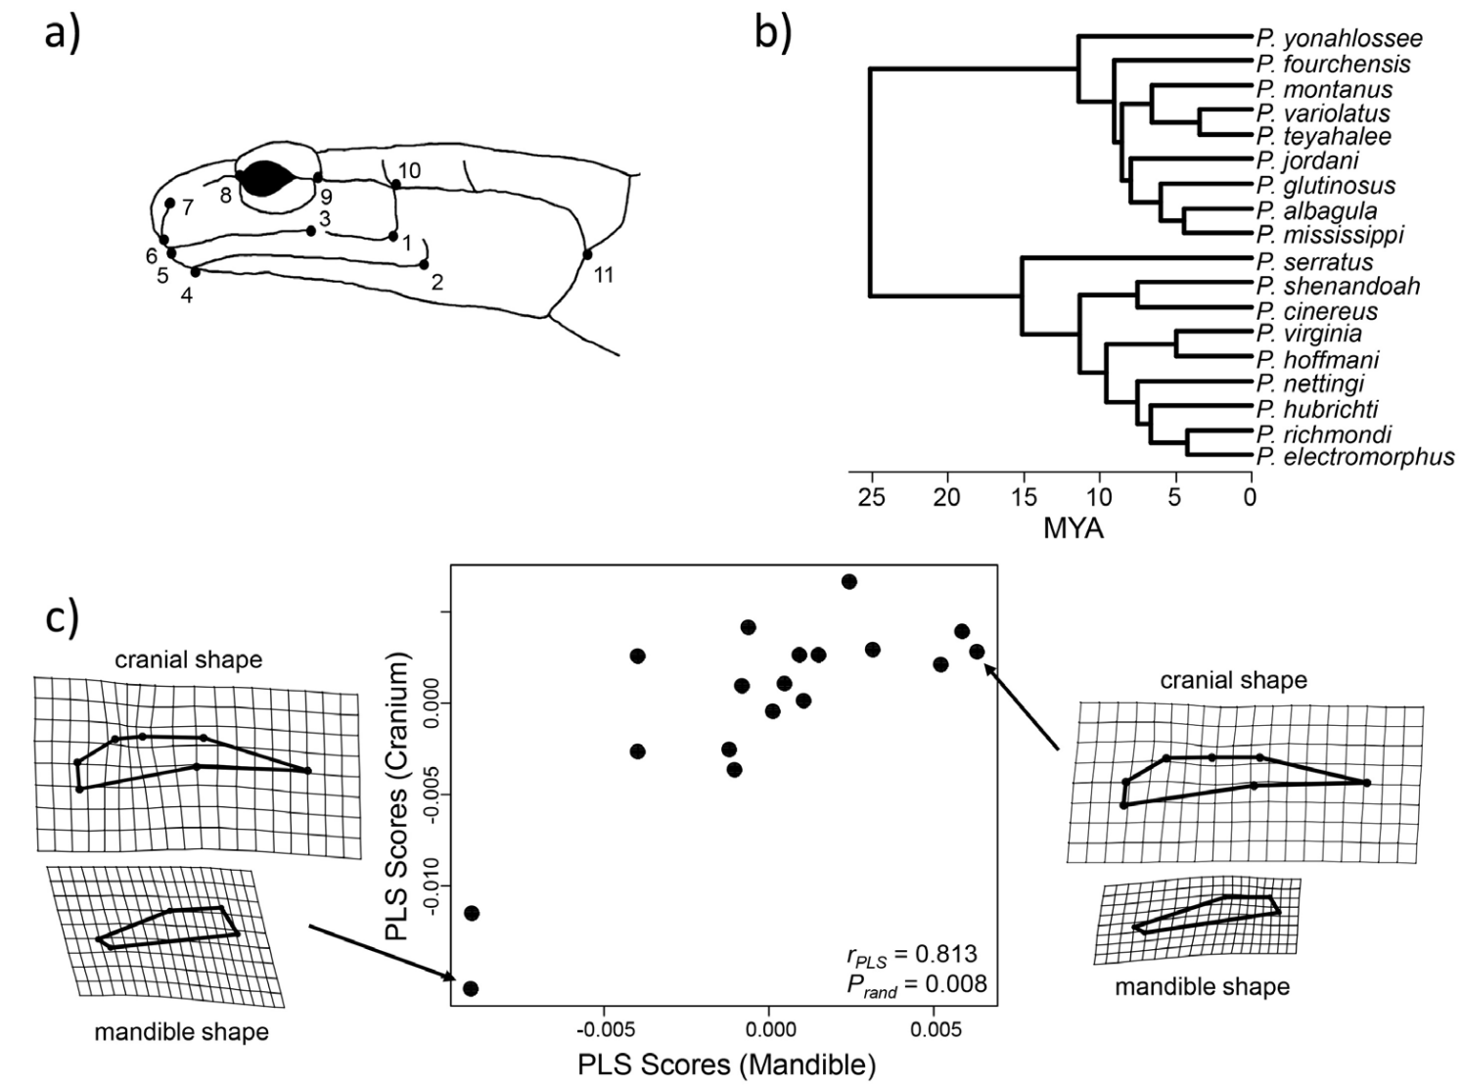

Slide 7
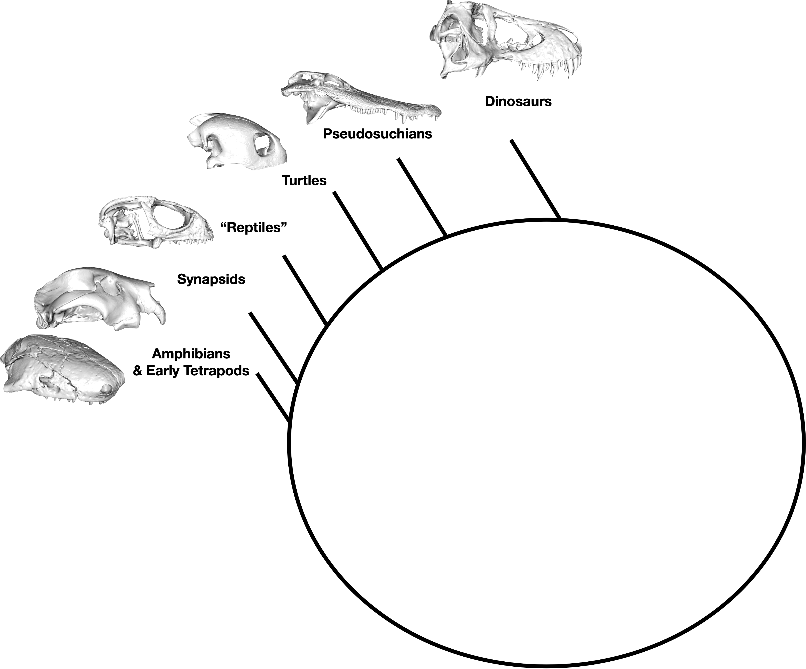
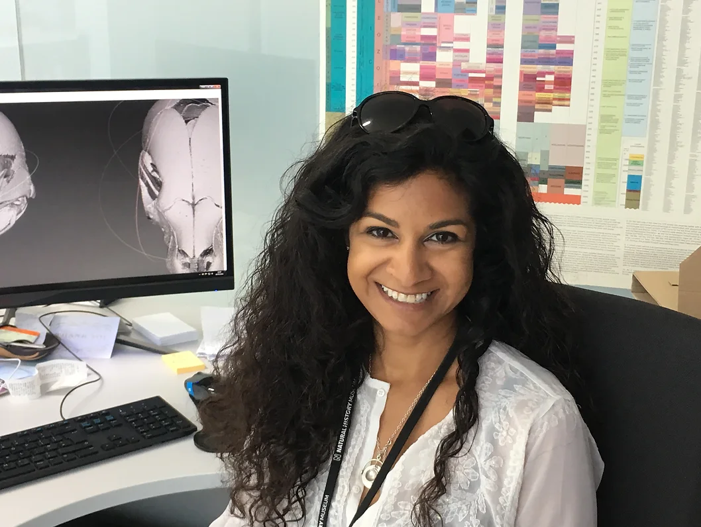
Postdoctoral Research
Skull evolution in tetrapods
Prof Anjali Goswami
Natural History Museum

Slide 8
Postdoctoral Research
Skull evolution in tetrapods
Prof Anjali Goswami
Natural History Museum

Slide 9
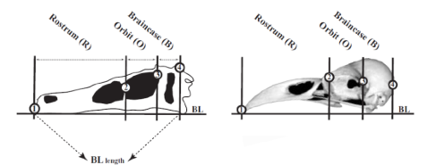
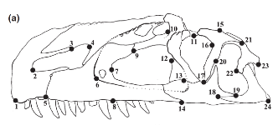
Marugán-Lobón and Buscalioni 2003
56 extinct dinosaur taxa + 52 birds
3 length measurements
Brusatte et al. 2012
36 taxa x 13 landmarks
26 taxa x 24 landmarks

Slide 10
Marugán-Lobón and Buscalioni 2003
56 extinct dinosaur taxa + 52 birds
3 length measurements
Brusatte et al. 2012
36 taxa x 13 landmarks
26 taxa x 24 landmarks

Slide 11
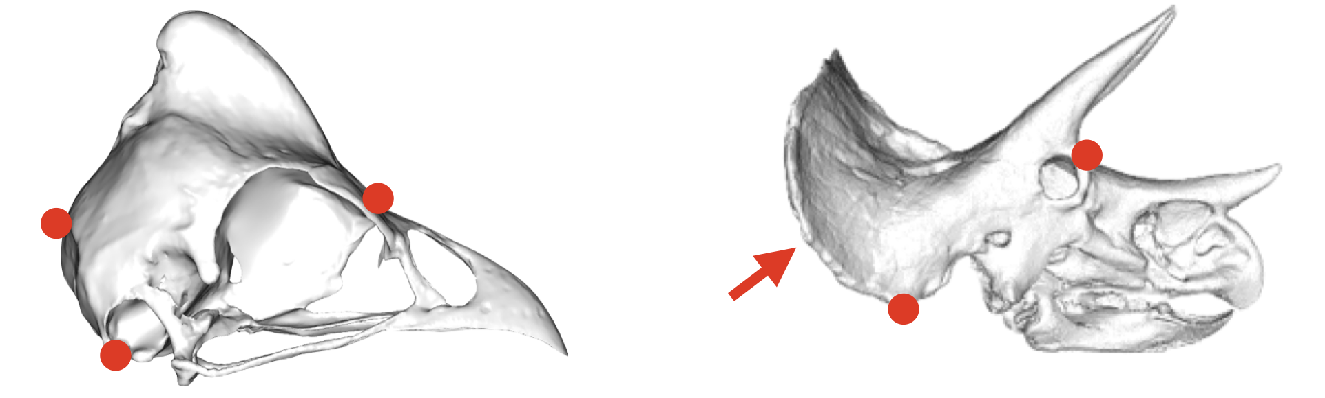
Dense Semi-landmarks allow complex shapes to be compared

Slide 12
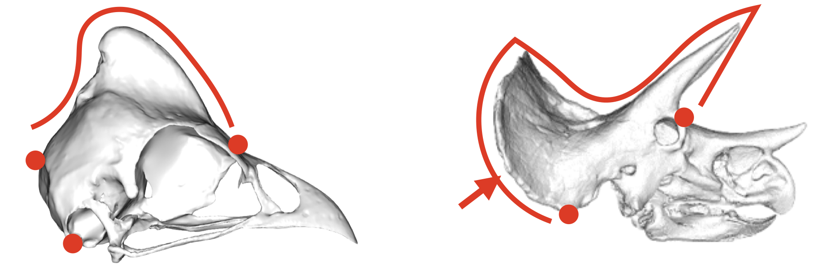
Dense Semi-landmarks allow complex shapes to be compared

Slide 13
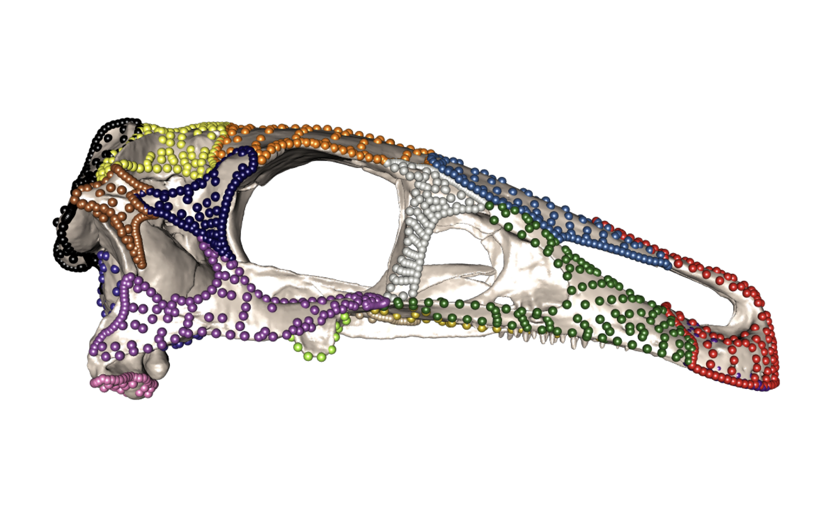

Slide 14
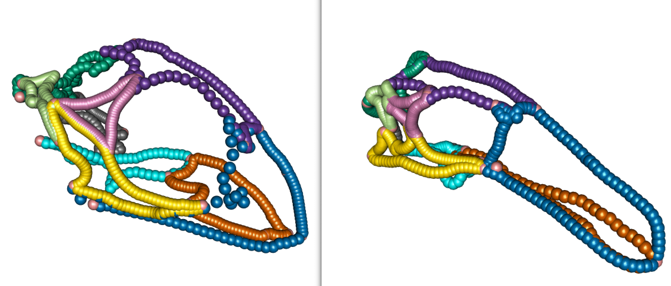
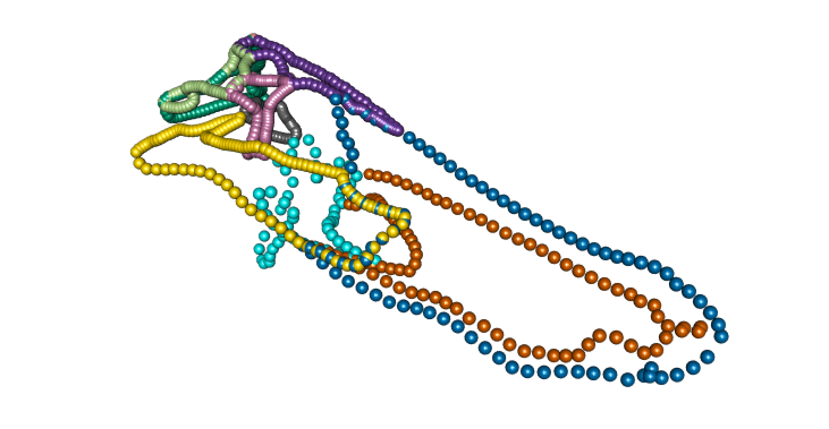

Slide 15
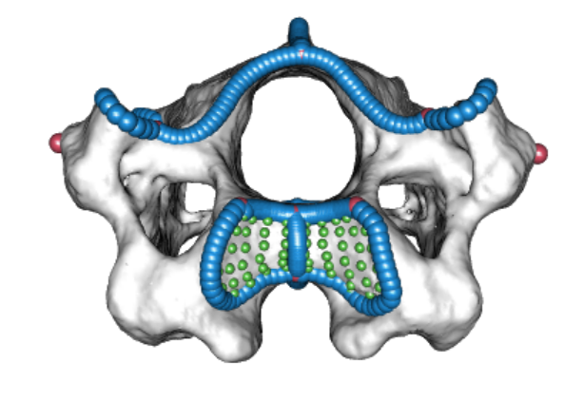
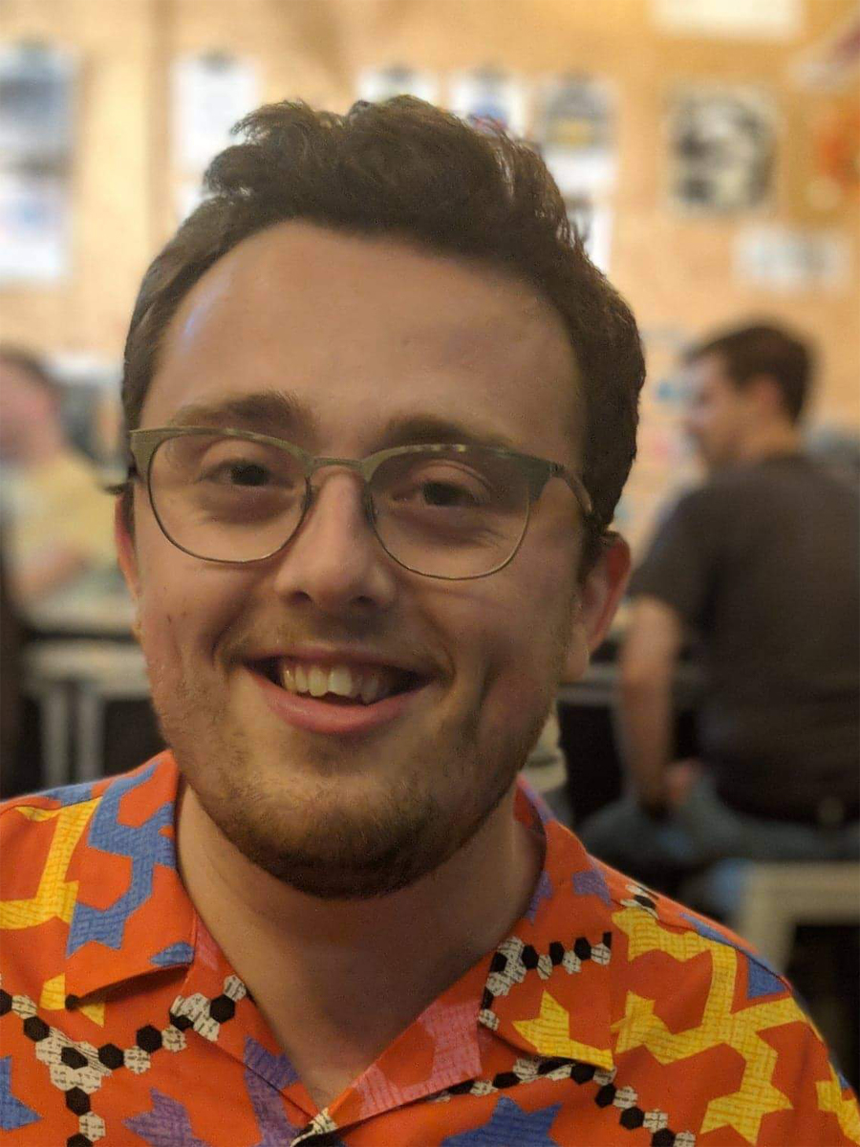
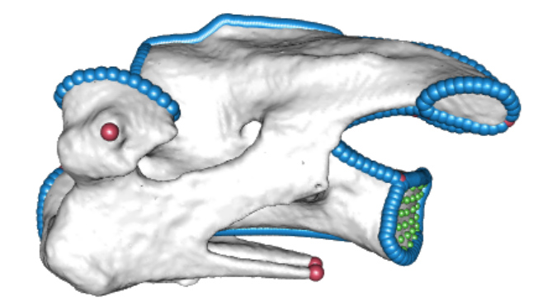
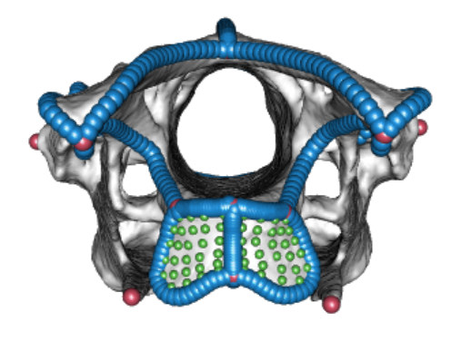
Trade-offs in vertebral evolution
Ryan Marek (postdoc)

Slide 16
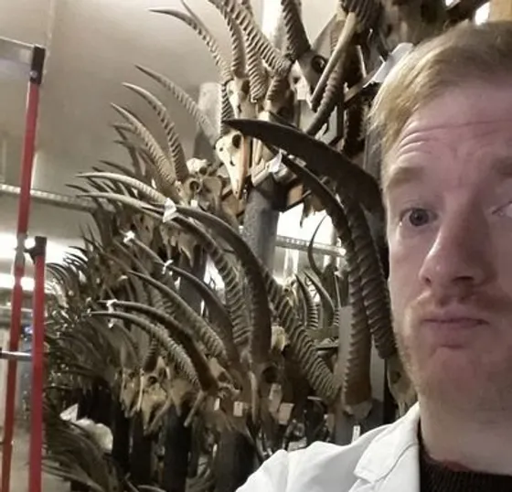
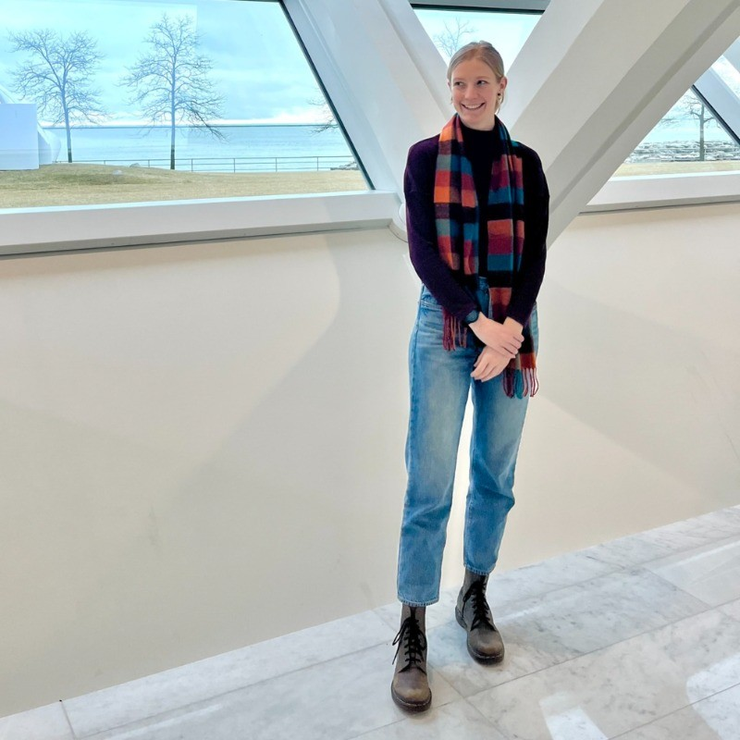
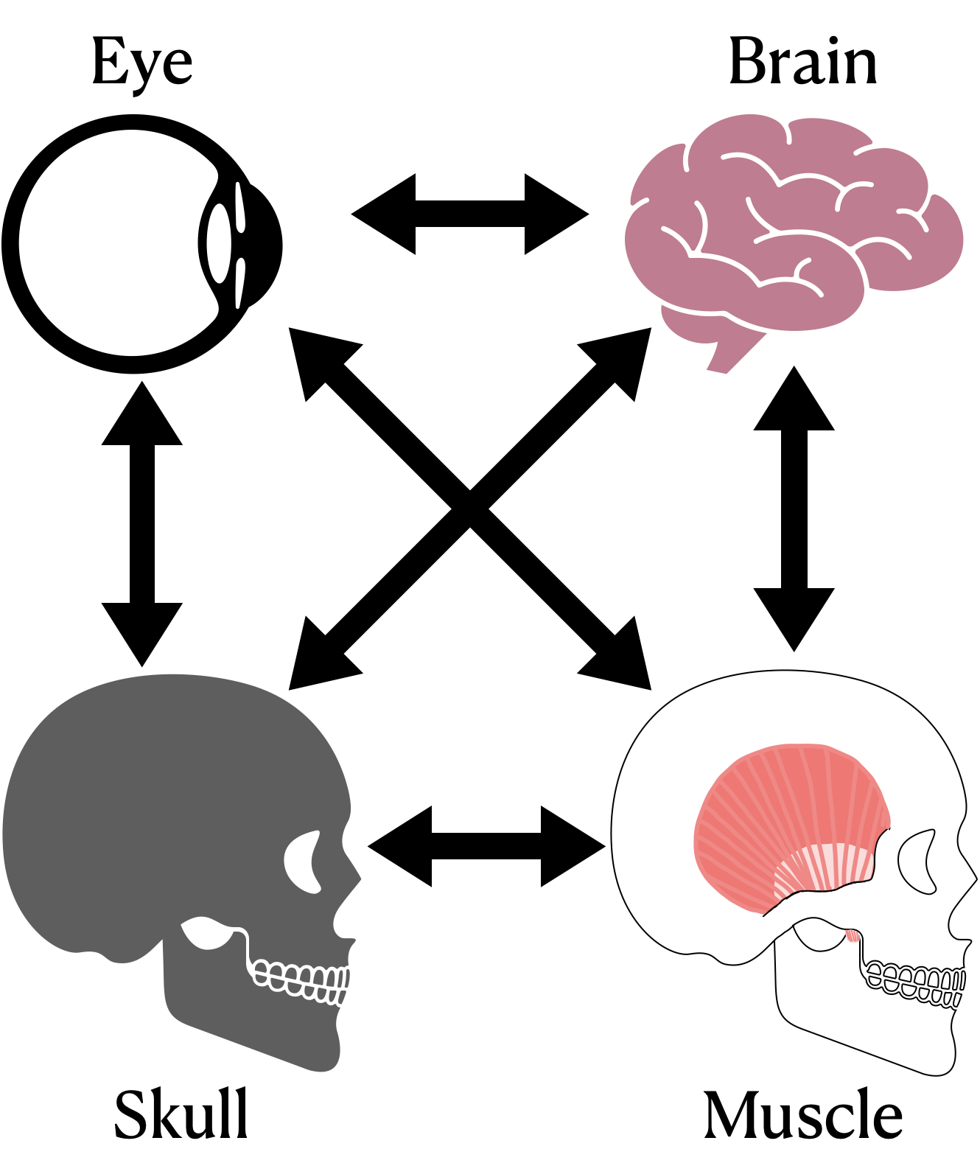
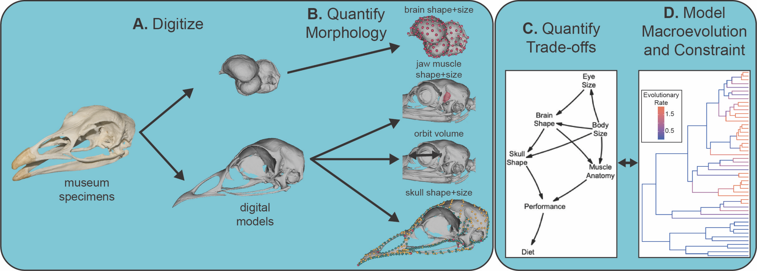
BRAIN-DRAIN: the consequences of encephalisation
Andy Knapp (postdoc)
Taylor West (postdoc)

Slide 17
What we will learn:
History of geometric morphometrics
How to collect 2D landmark data
How to collect 2D outline data
How to conduct analyses with landmark and outline data

Slide 18
Who are you?

